Slide 1
Parse scRNAseq Summary
Yong Lin

Slide 2
Samples Summary
total sort count
ht9: 245136
ht11: 728053
ht12: 76760
ht14: 1036766

Slide 3
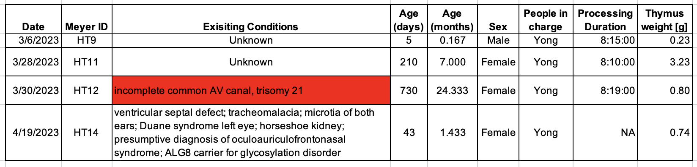
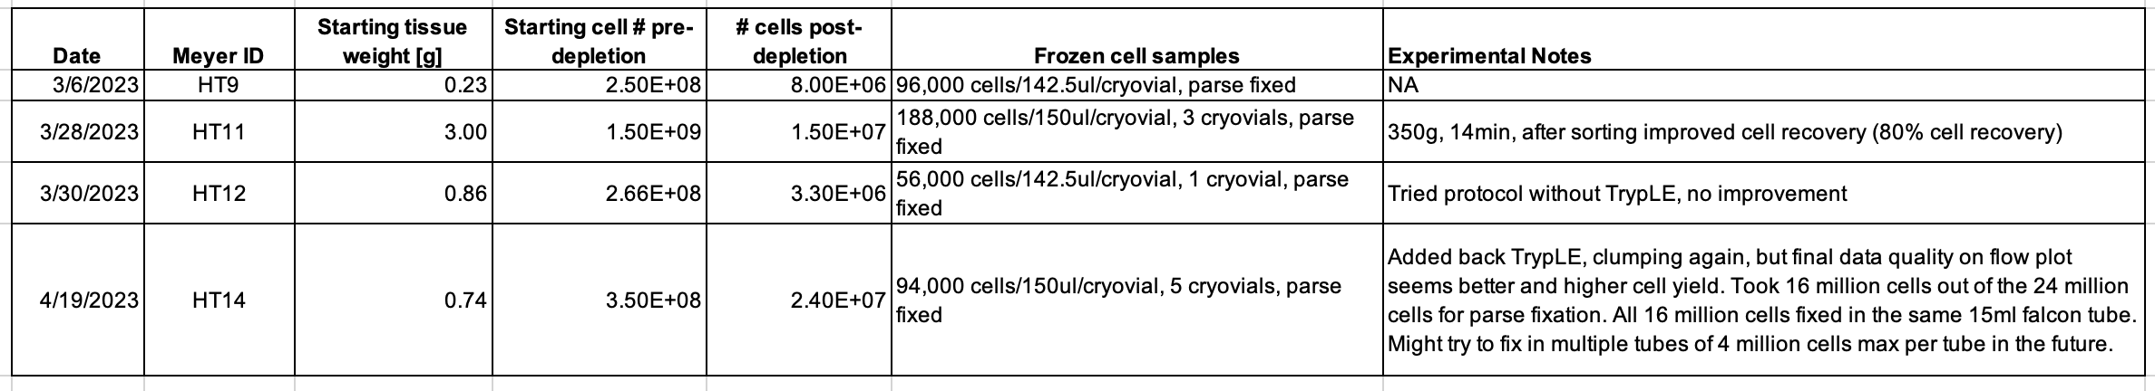
Samples Summary

Slide 4
QC plots
Linear scale
Log scale

Slide 5
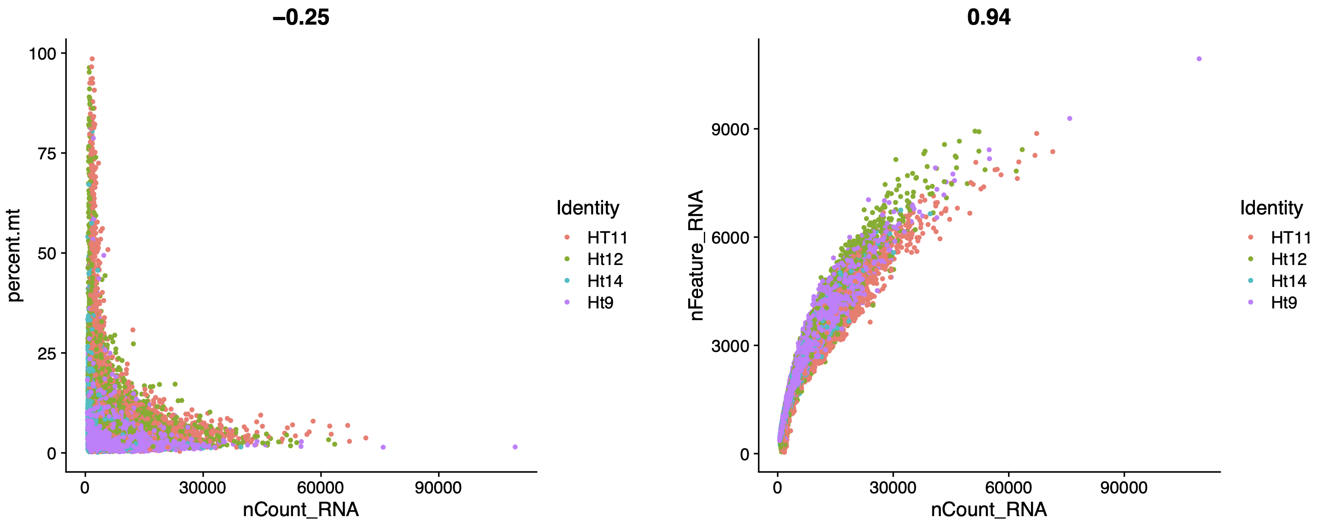
QC plots

Slide 6
QC plots
nFeature
nCount
Percent.mt

Slide 7
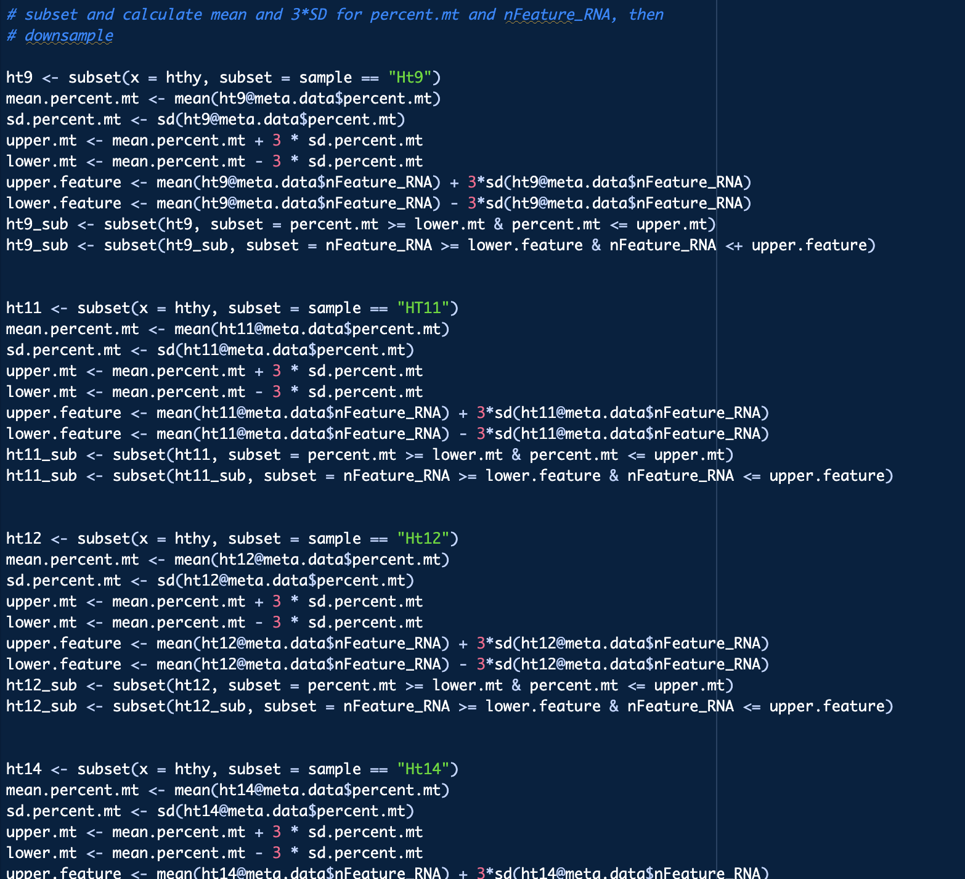
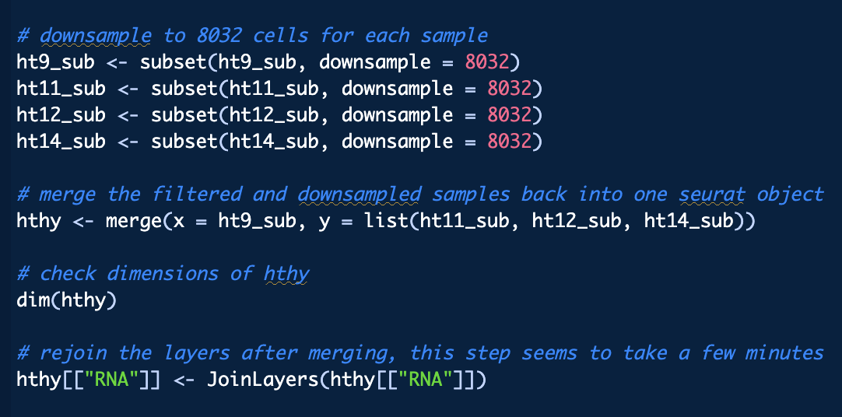
Subset > QC filter > downsample > merge

Slide 8
QC plots: post filter
Linear scale
Log scale

Slide 9
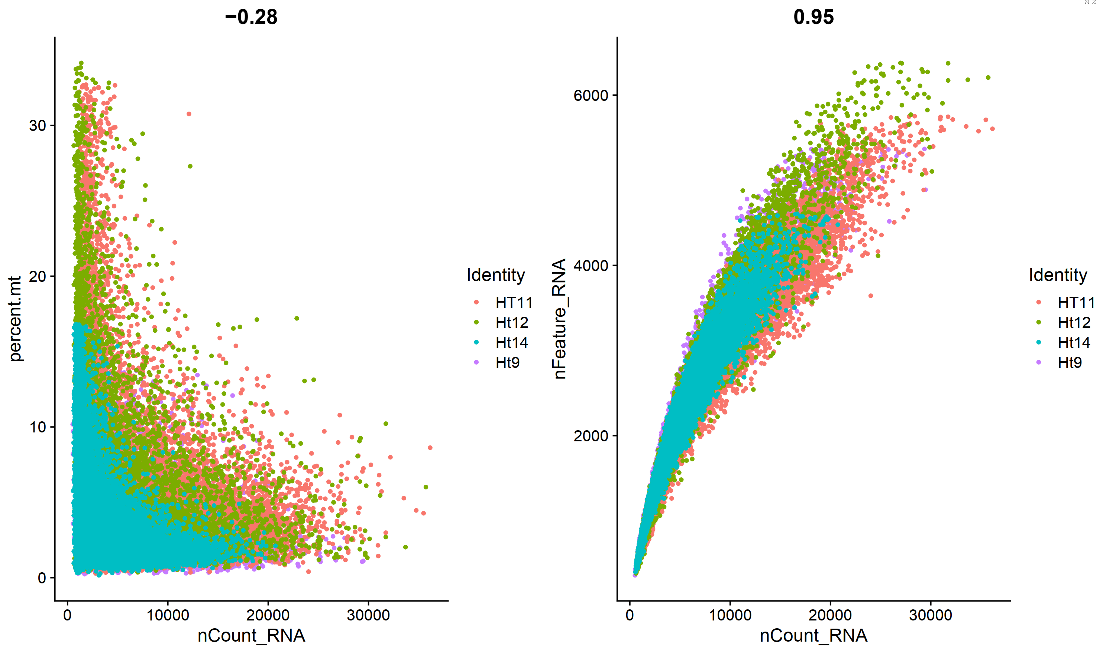
QC plots: post filter

Slide 10
QC plots: post filter
nFeature
nCount
Percent.mt

Slide 11
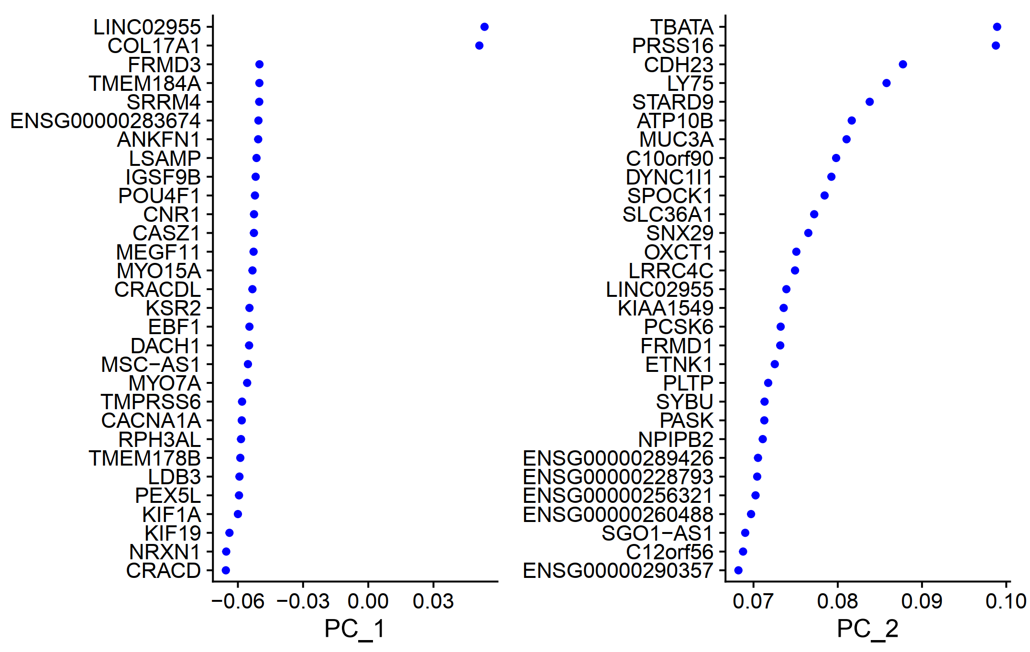

Slide 12
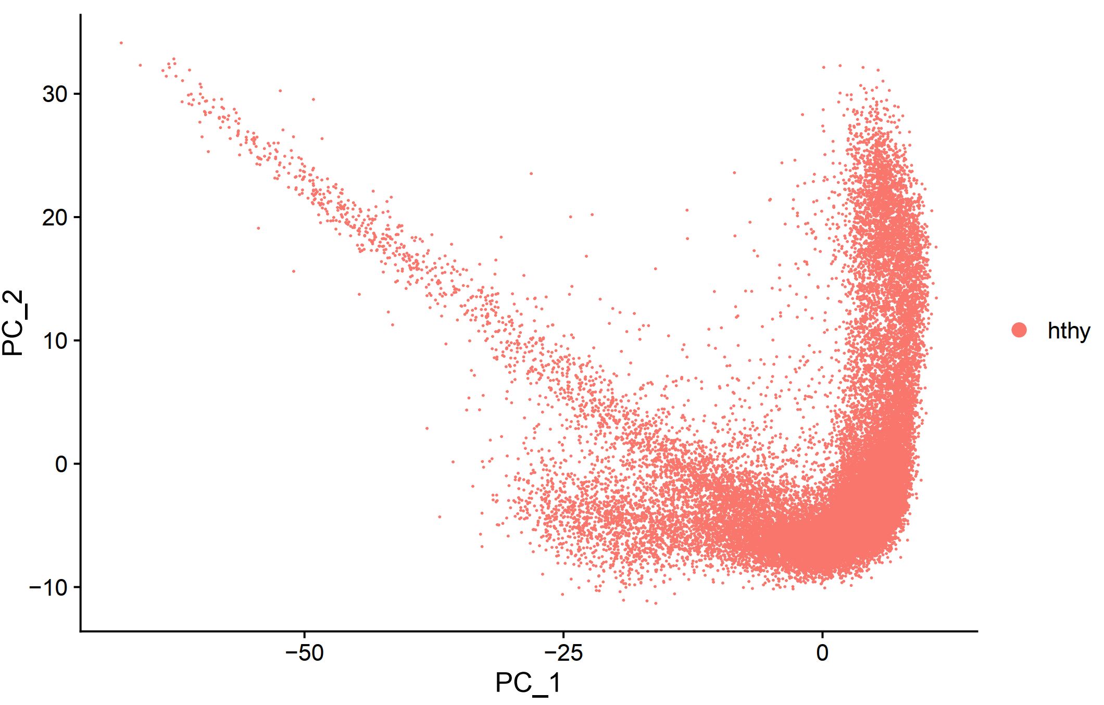
PCA

Slide 13
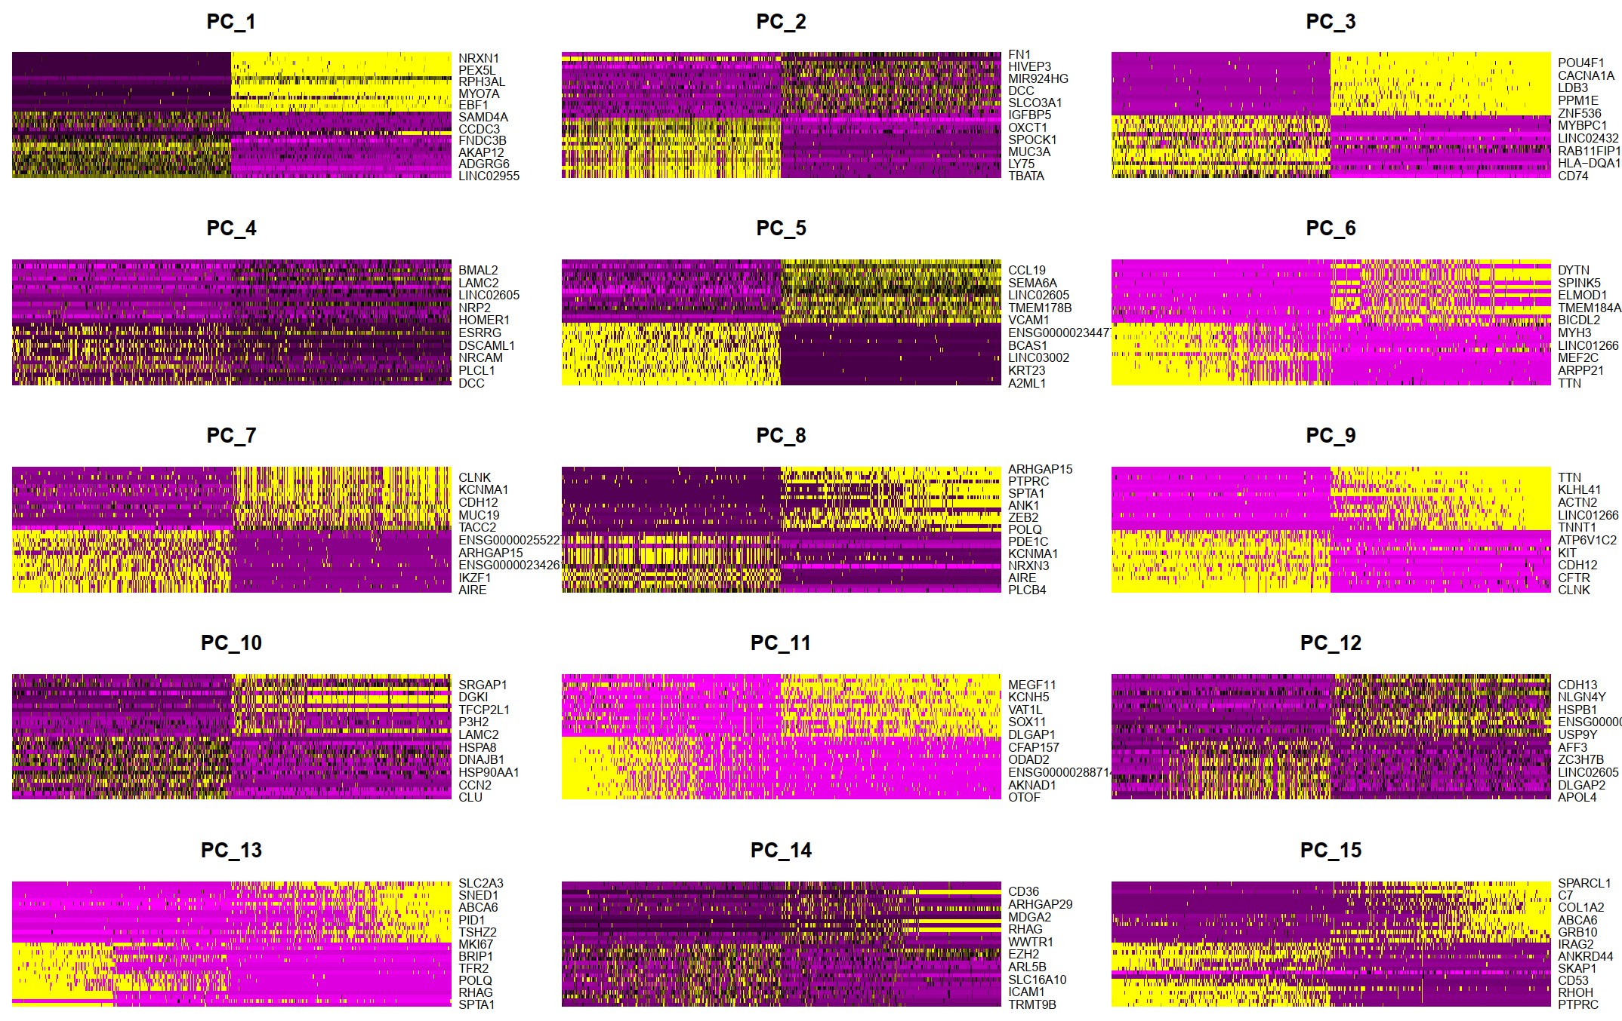

Slide 14
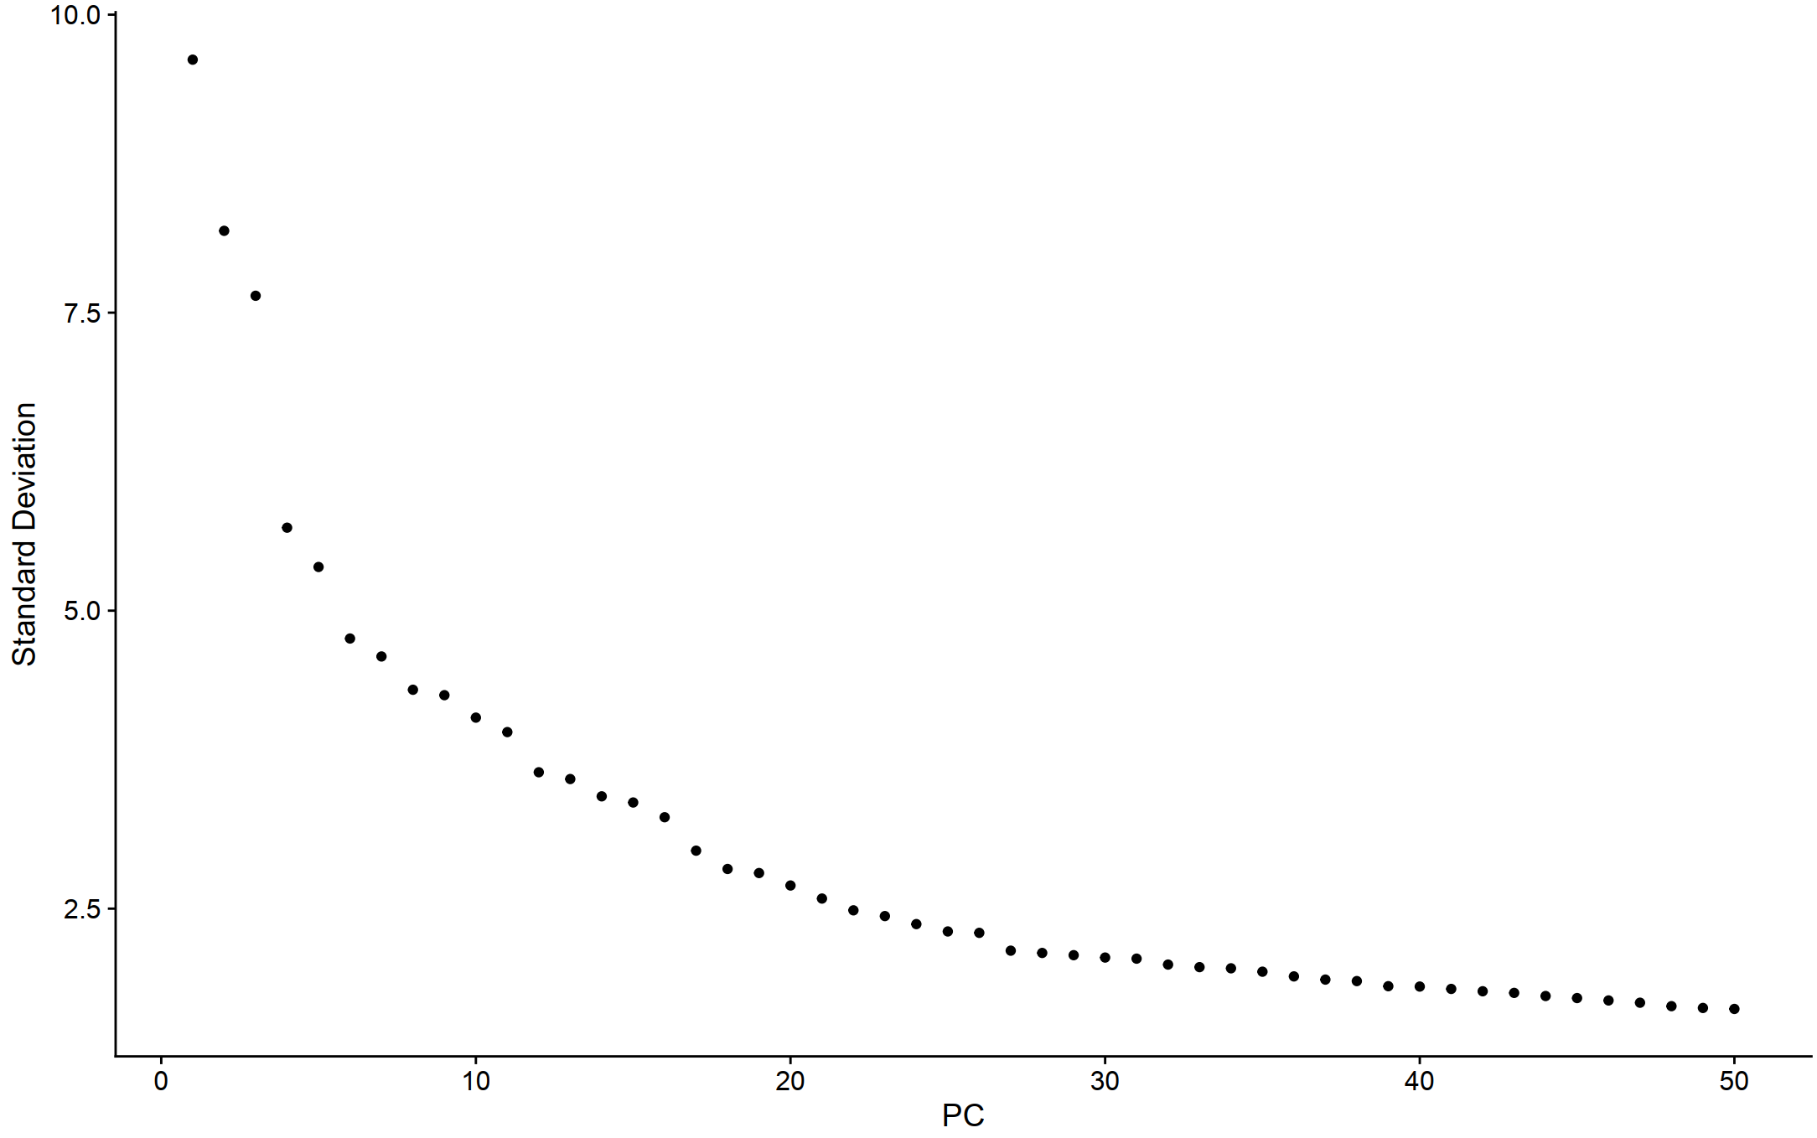
Elbow plot

Slide 15
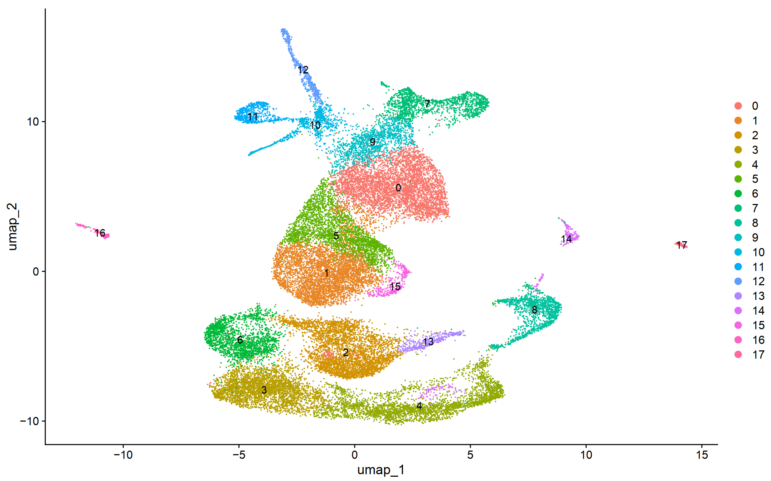
UMAP clusters

Slide 16
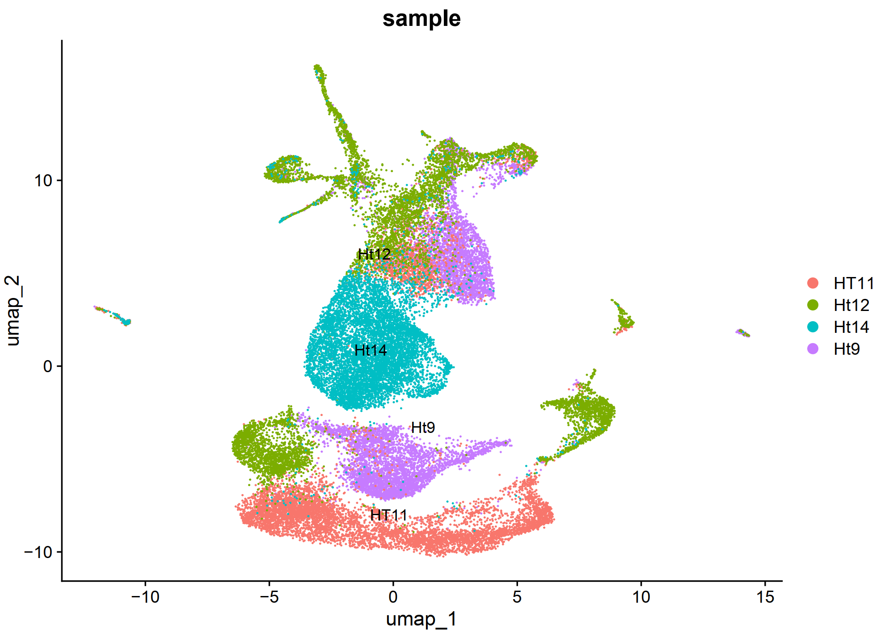
Group by sample

Slide 17
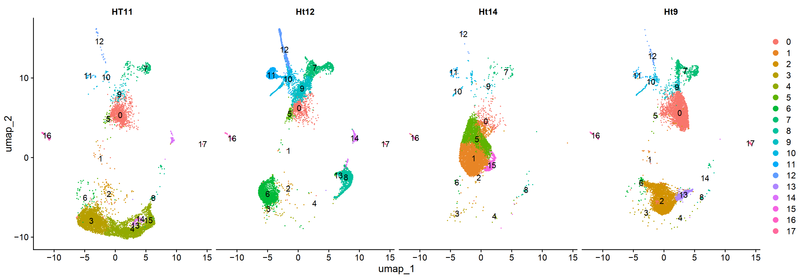
Split by sample

Slide 18
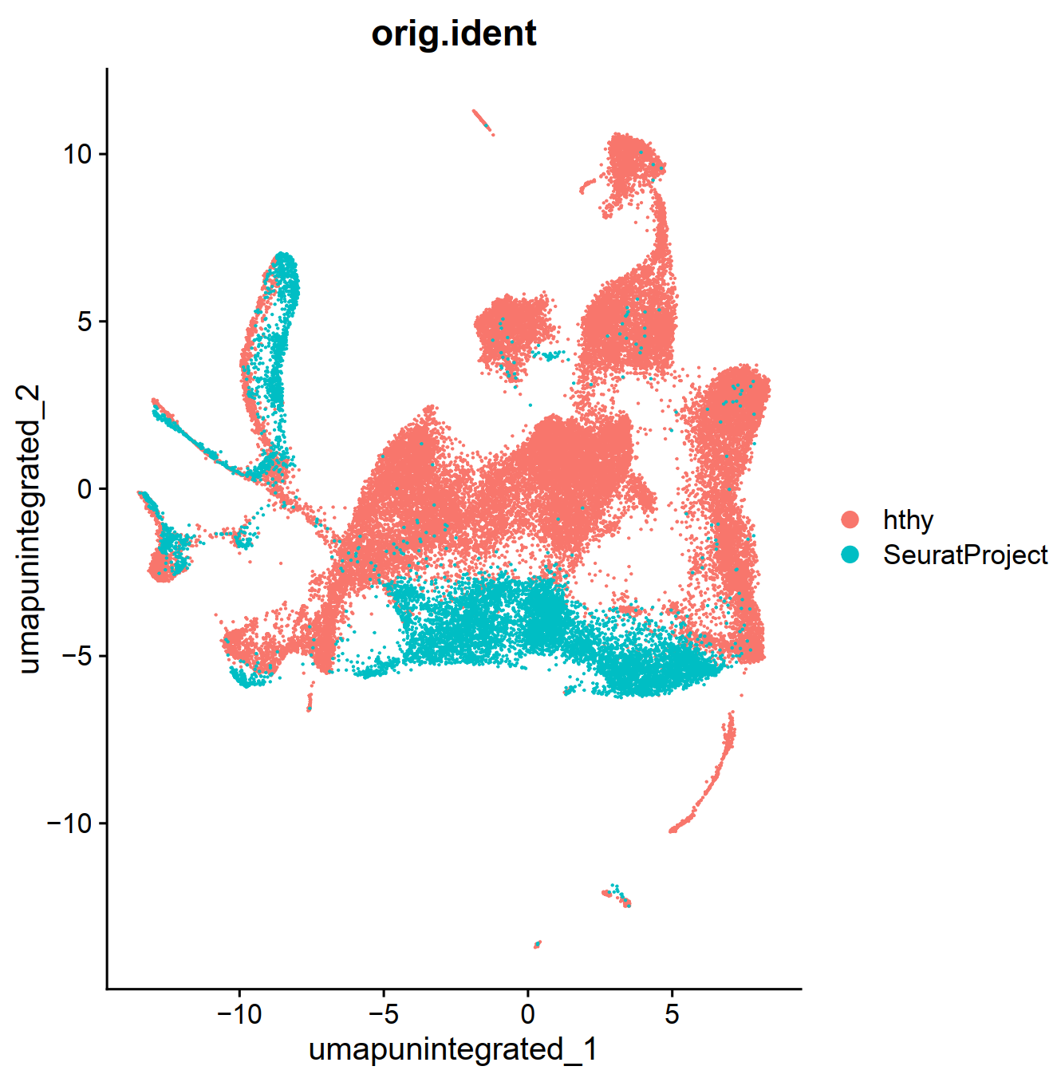
Merged but without integration

Slide 19
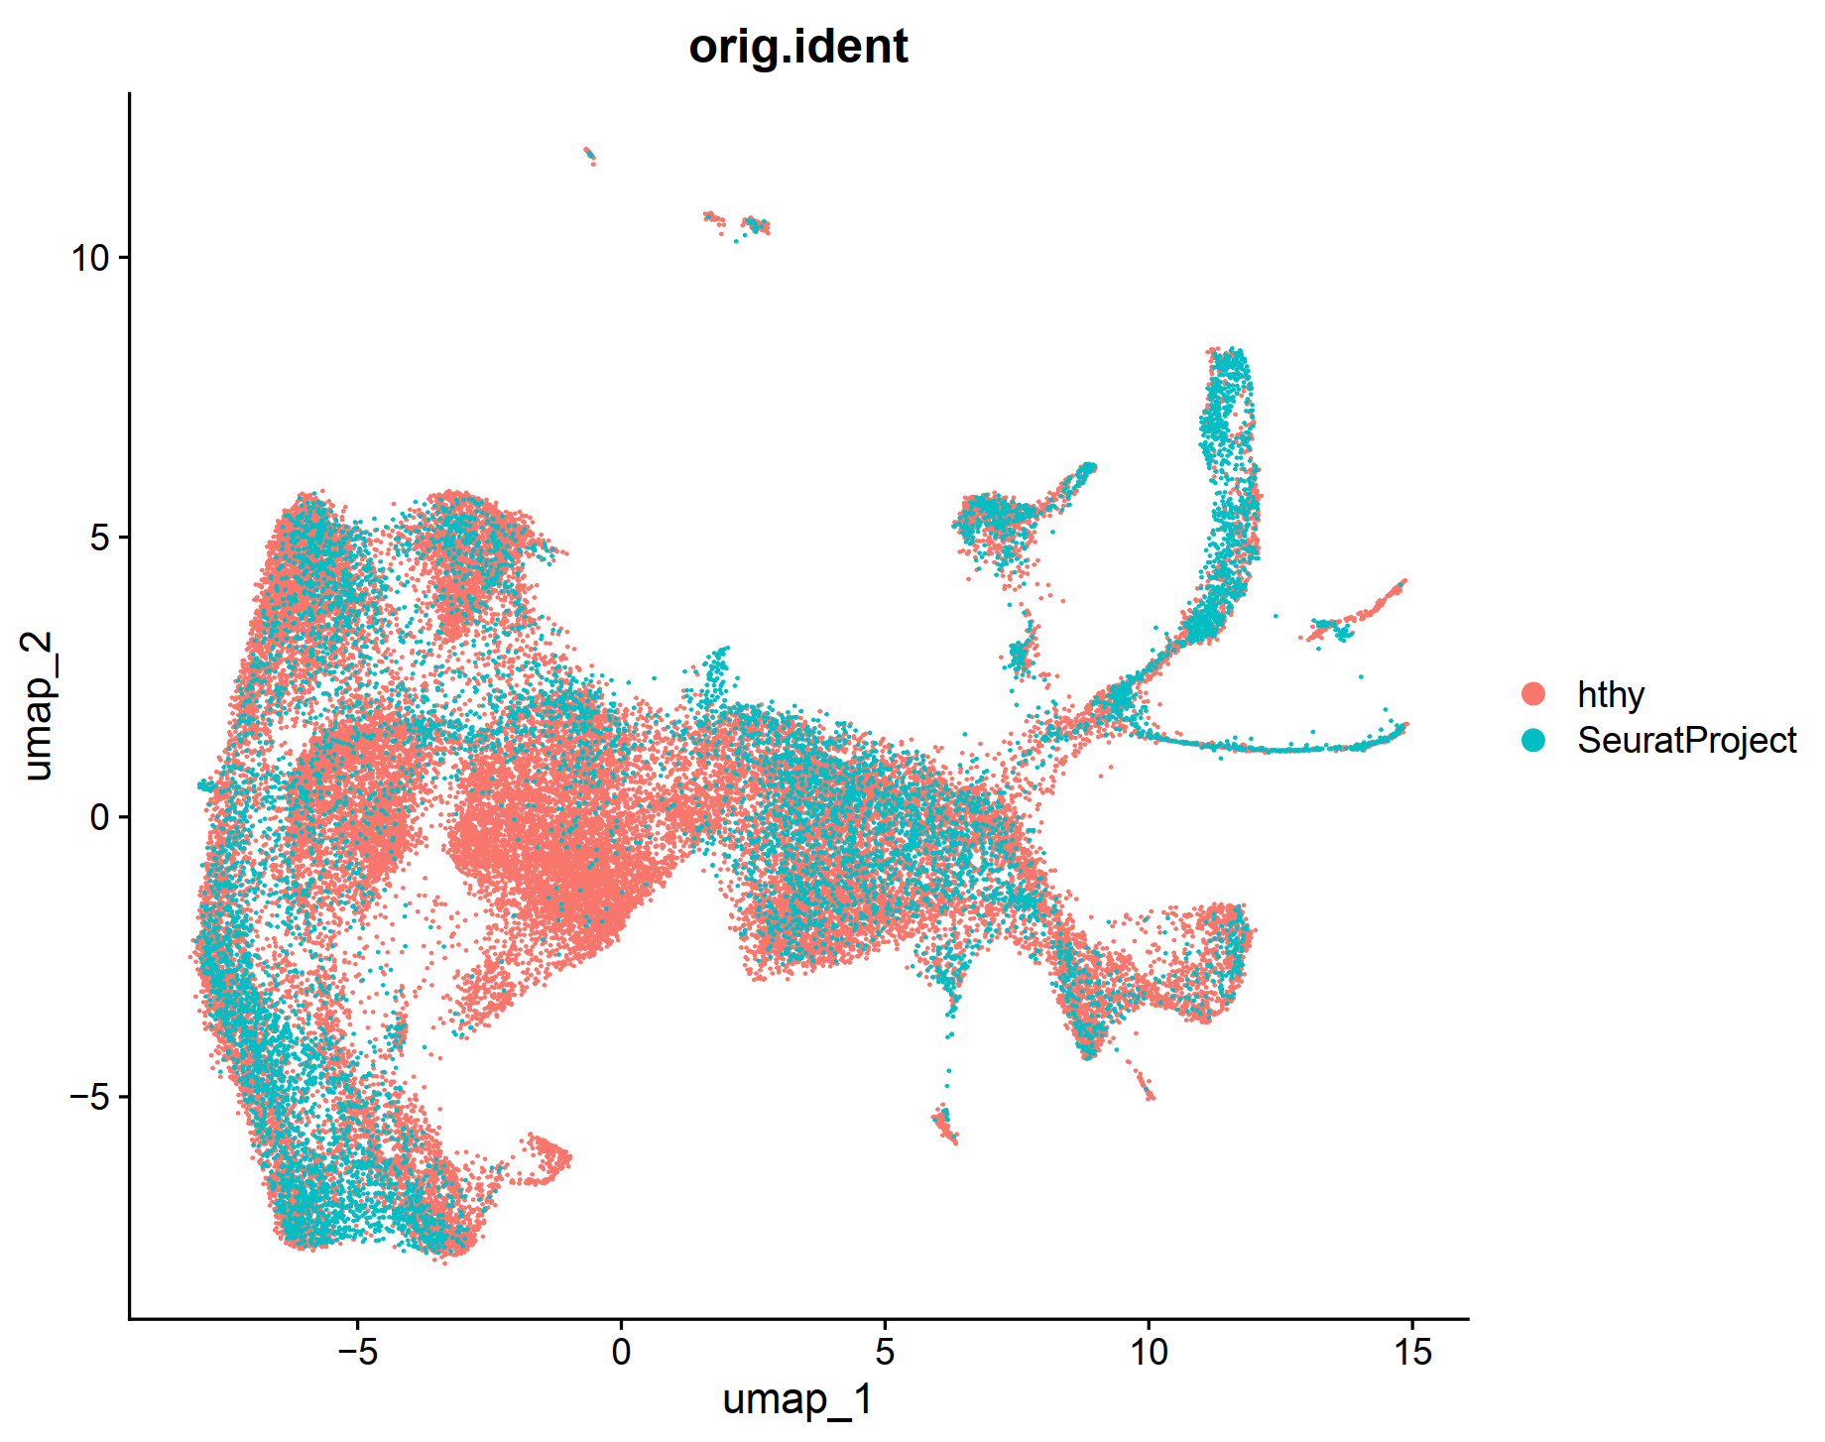
Merged, integrated by live vs fixed

Slide 20
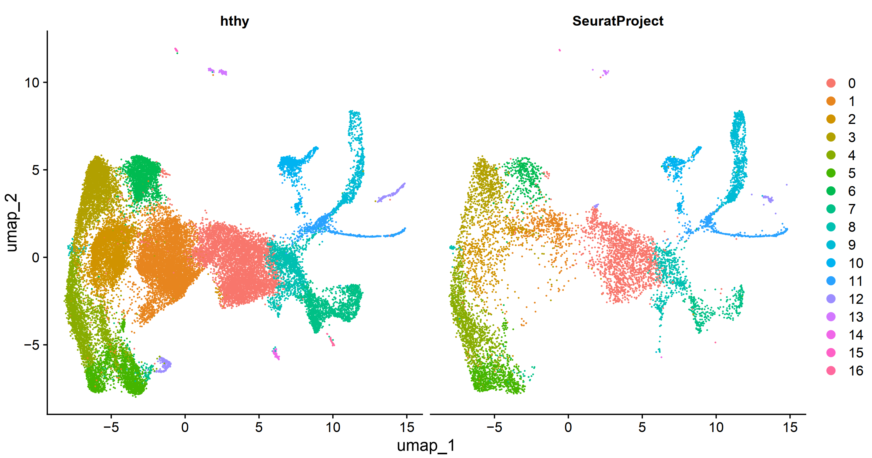
Integrated, split by fixed vs live

Slide 21
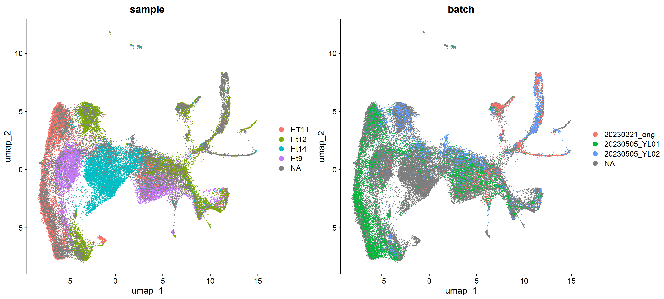
Integrated, split by fixed vs live, group by sample

Slide 22
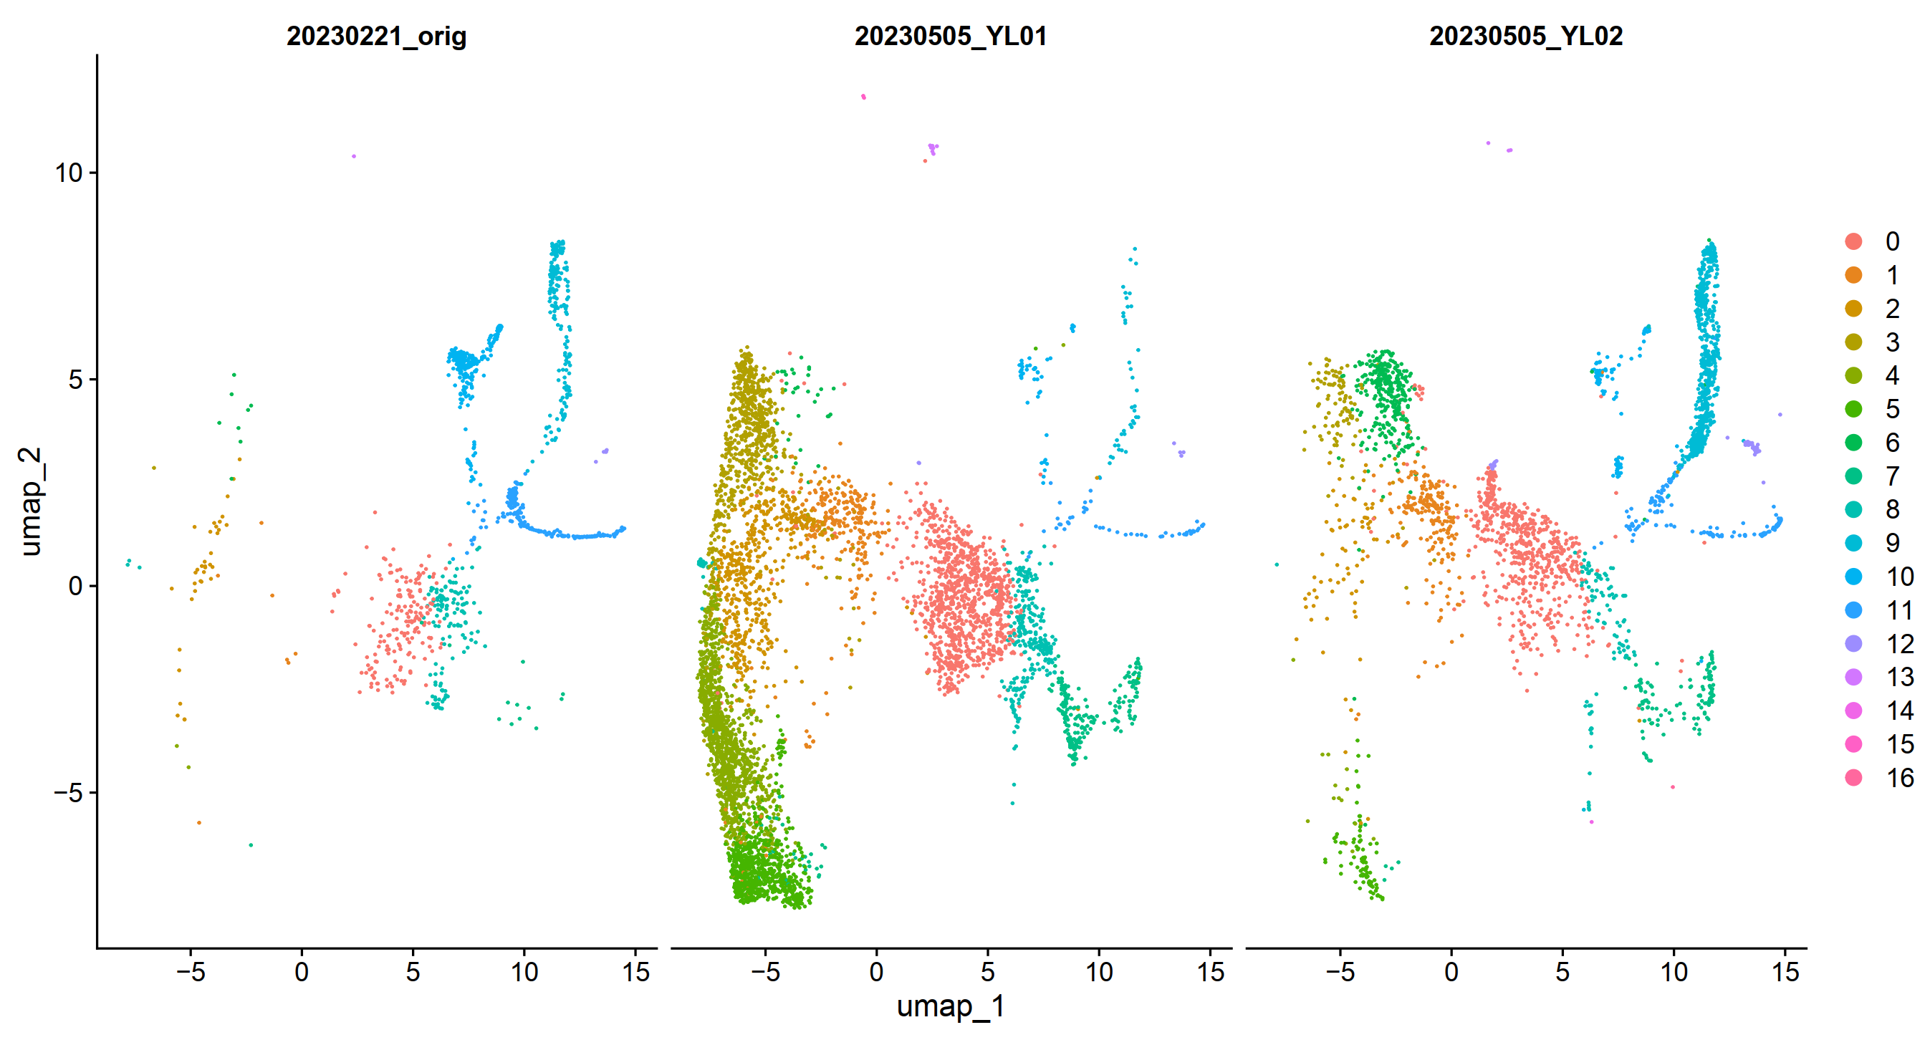
Integrated, live cells, split by sample, group by cluster

Slide 23
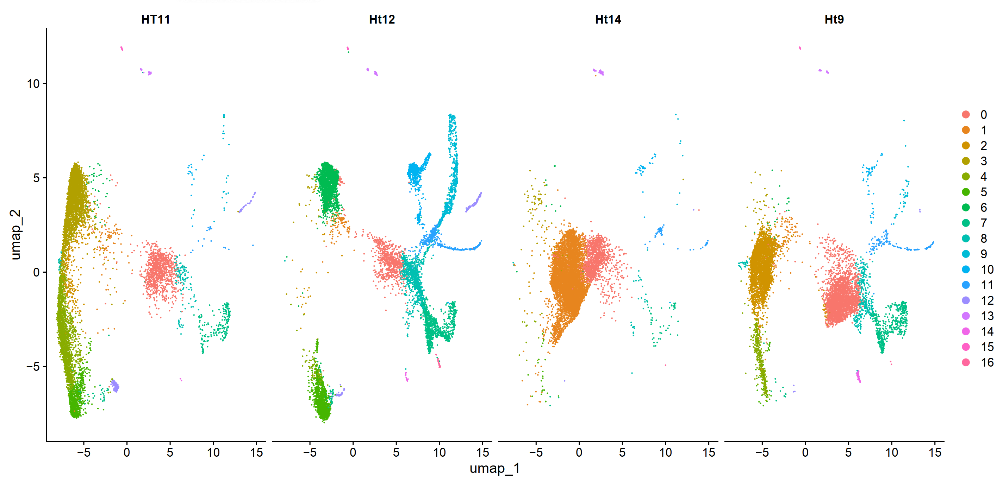
Integrated, fixed cells, split by sample, group by cluster

Slide 24
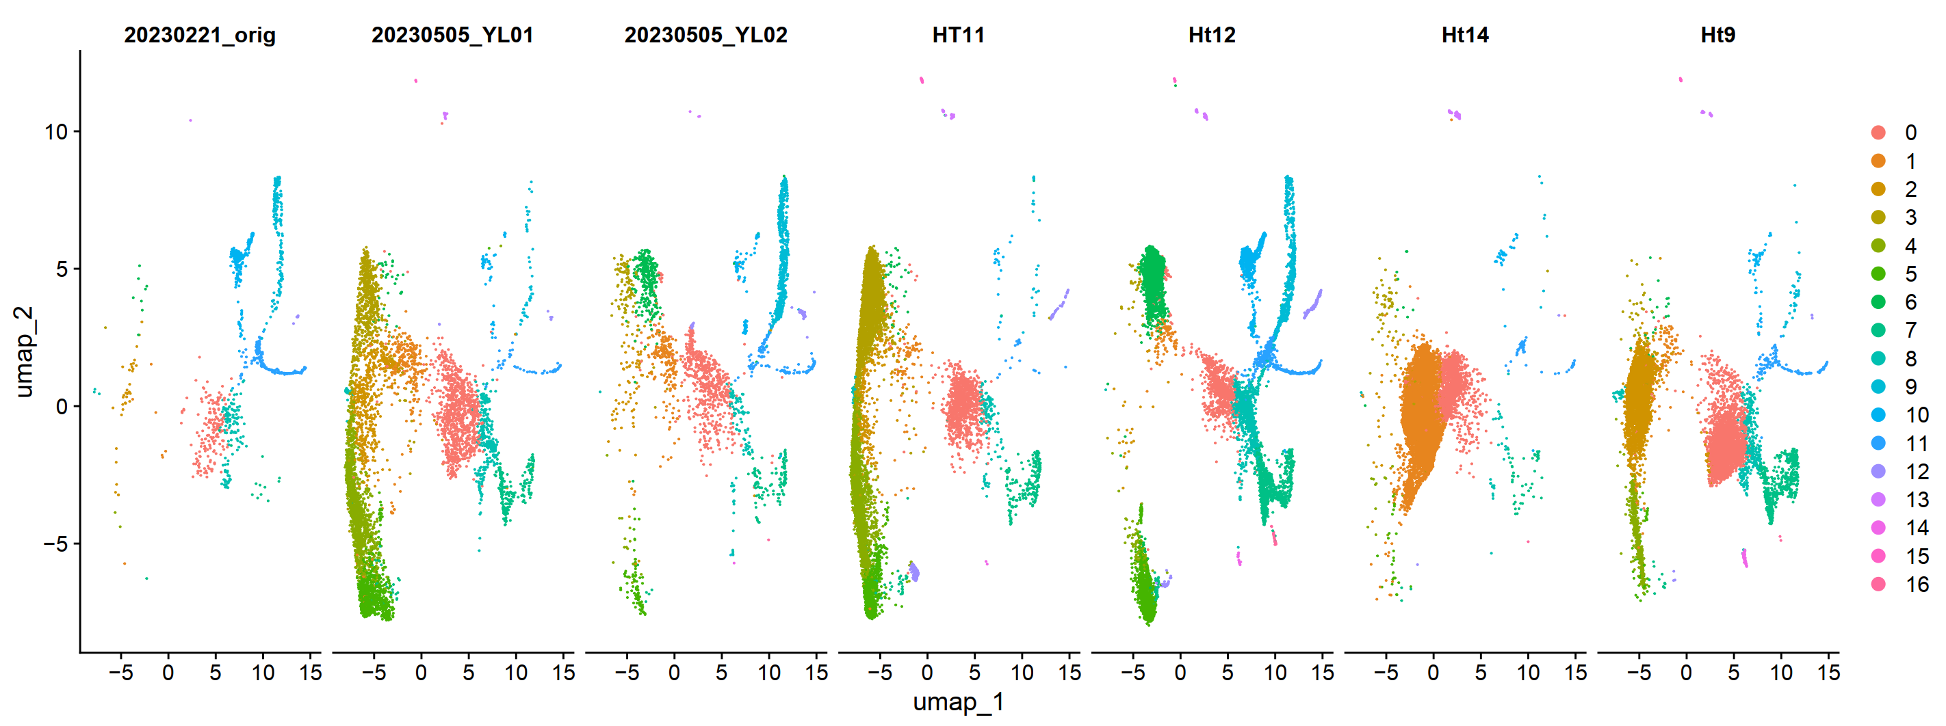
Integrated, merged sample ID, split by sample, group by cluster

Slide 25
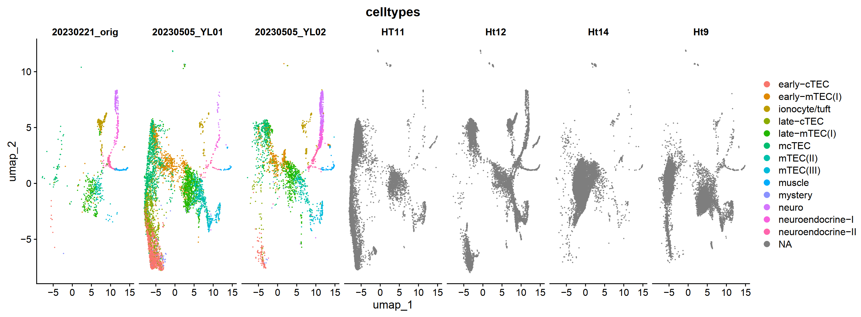
Integrated, merged sample ID, split by sample, group by cell type, label not transferred

Slide 26
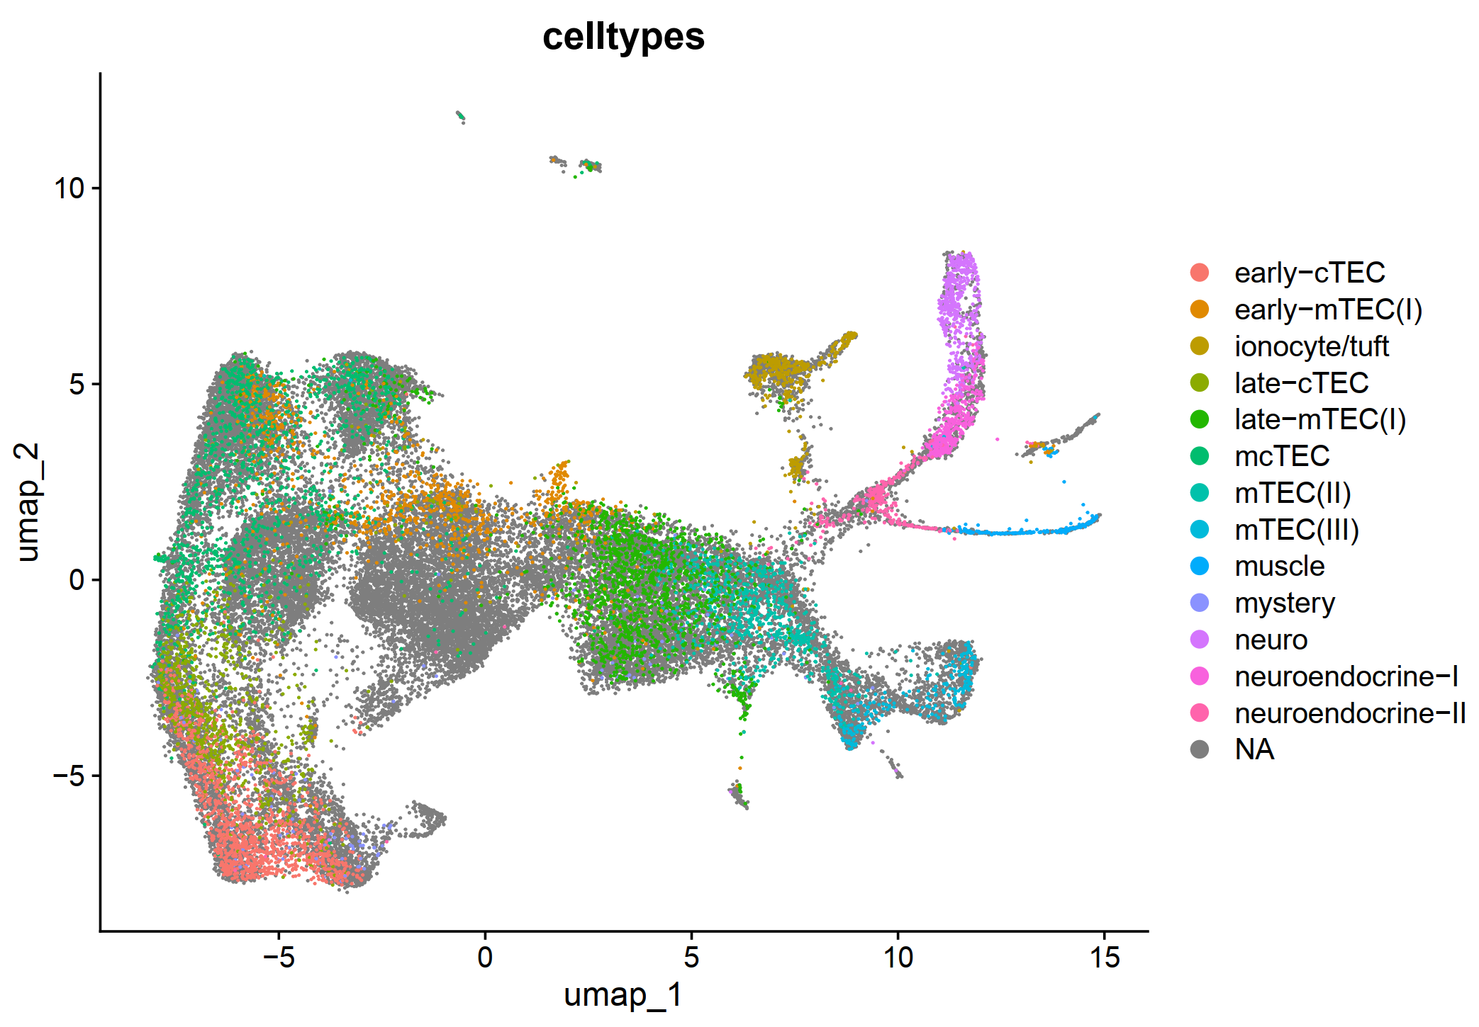
Integrated, group by cell type, label not transferred

Slide 27
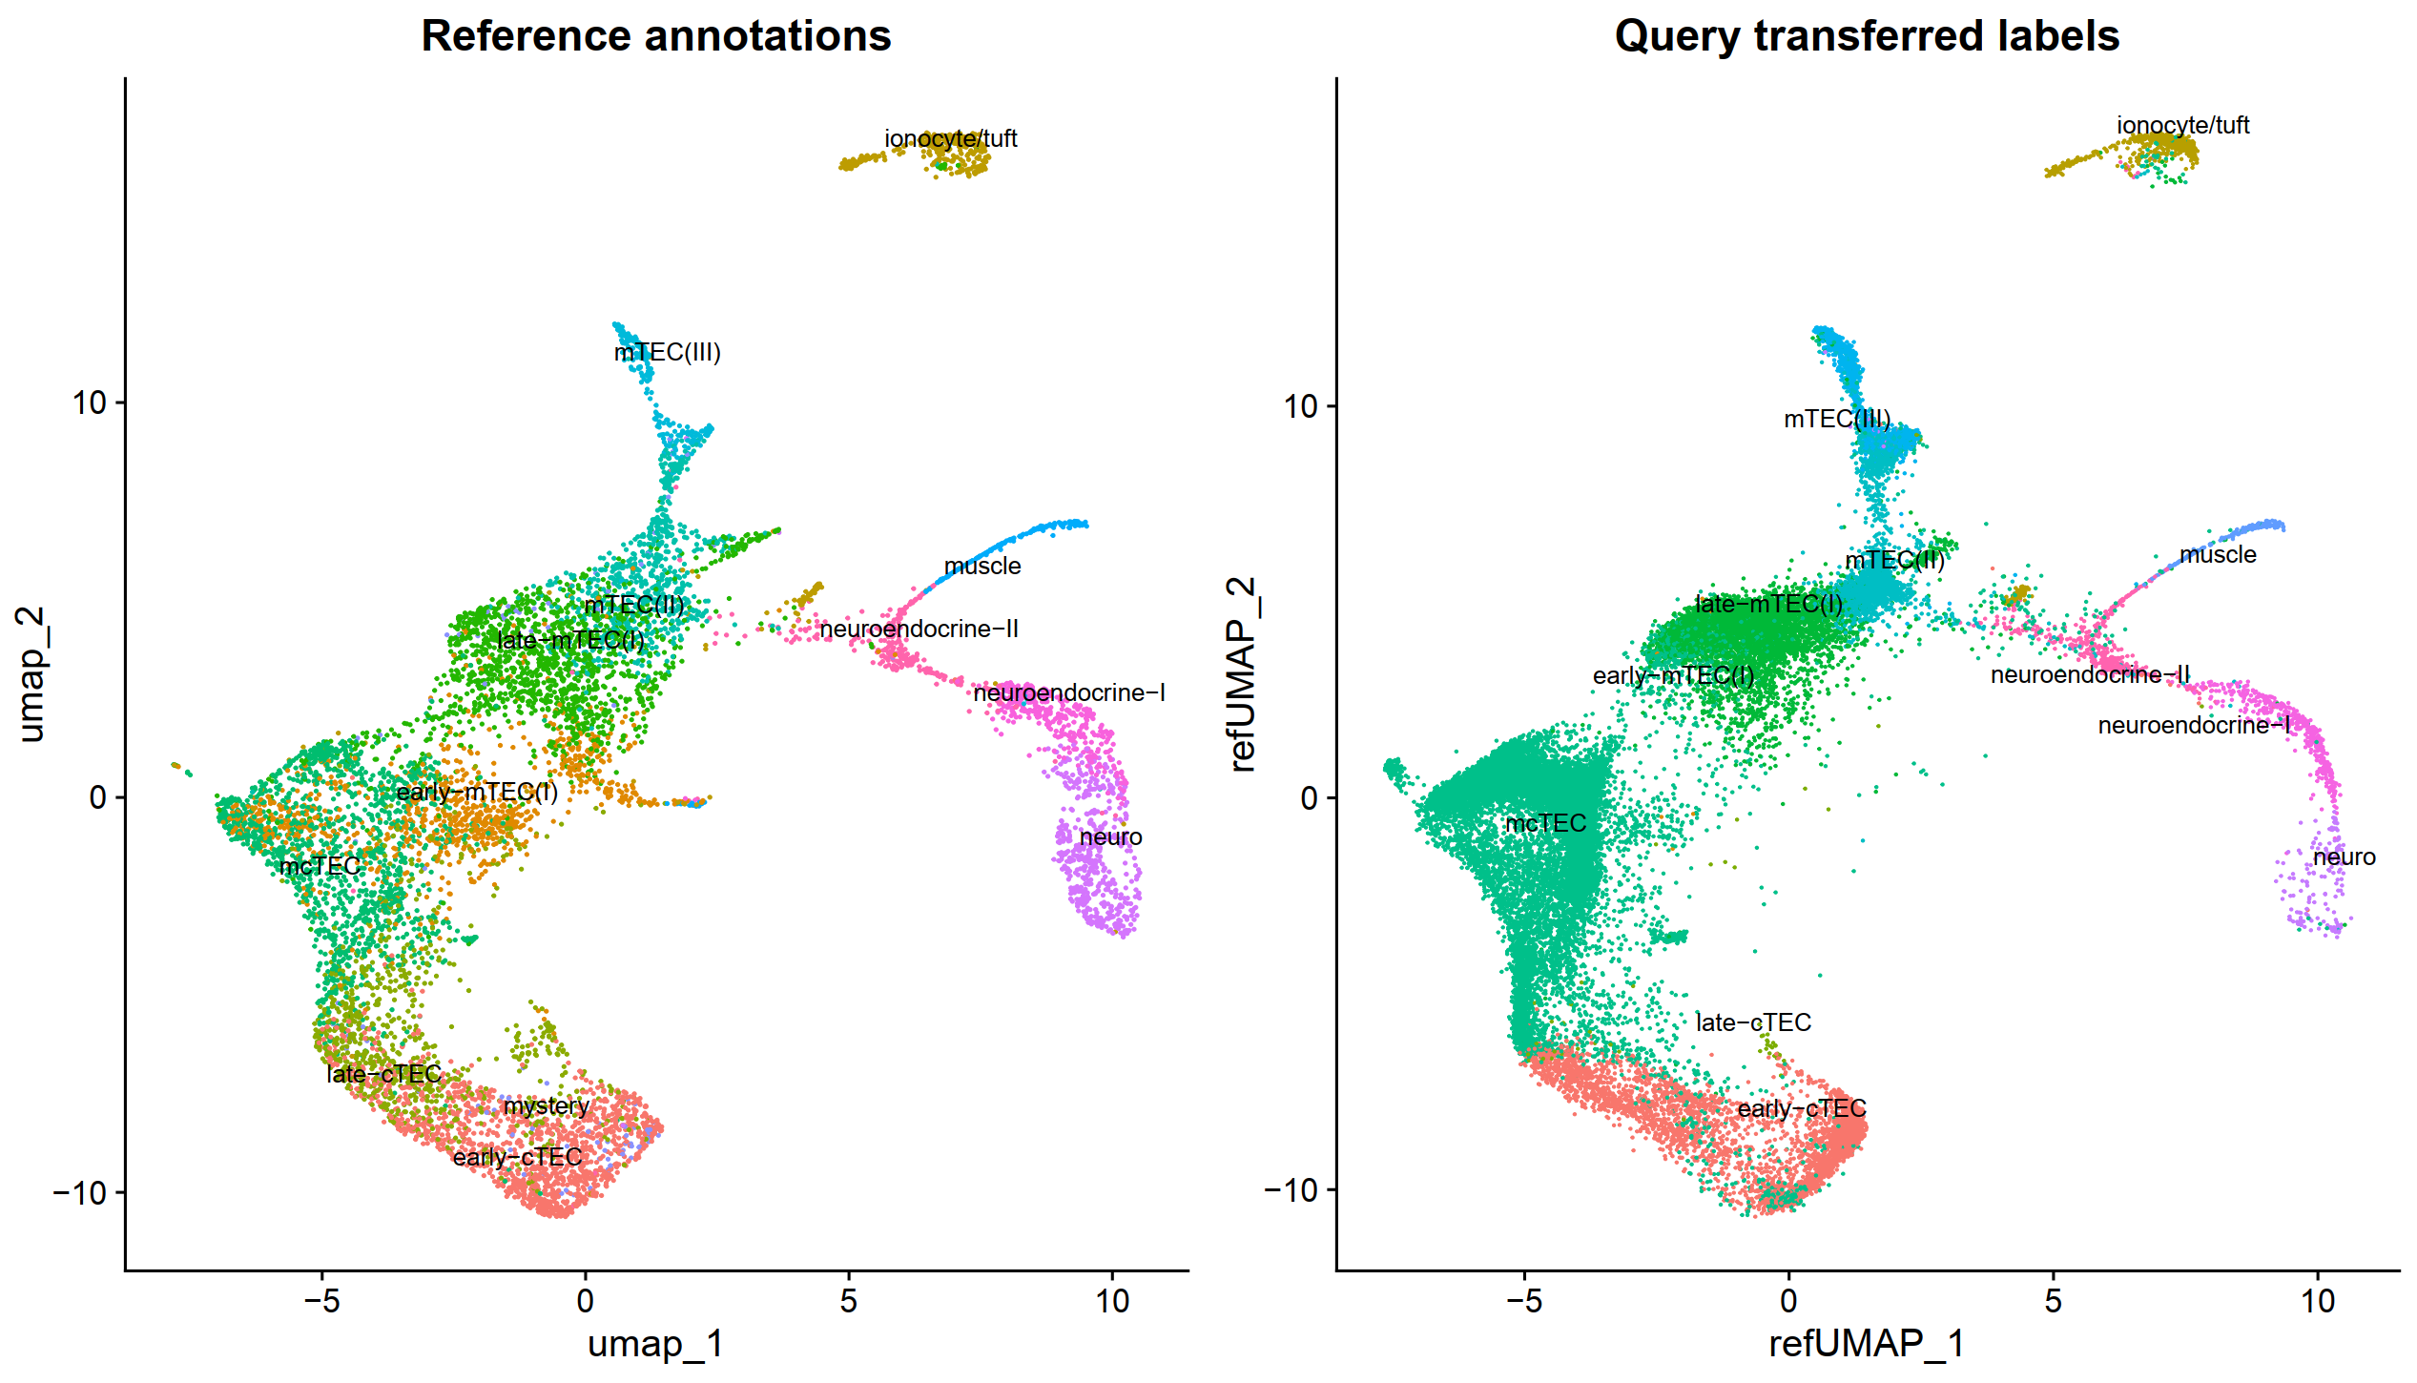
Integrated, group by cell type, label transferred, project onto reference umap

Slide 28
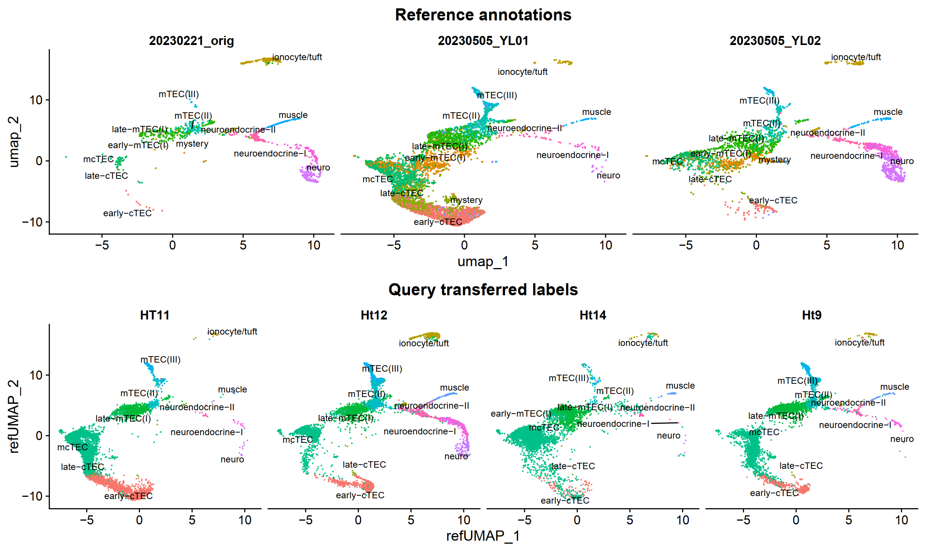
Integrated, group by cell type, label transferred, project onto reference umap

Slide 29
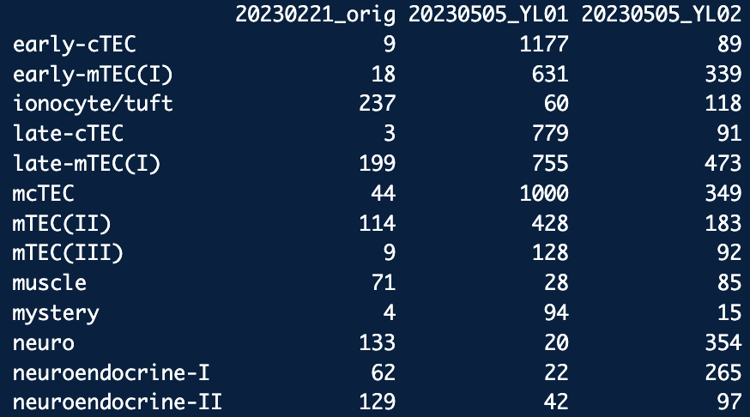
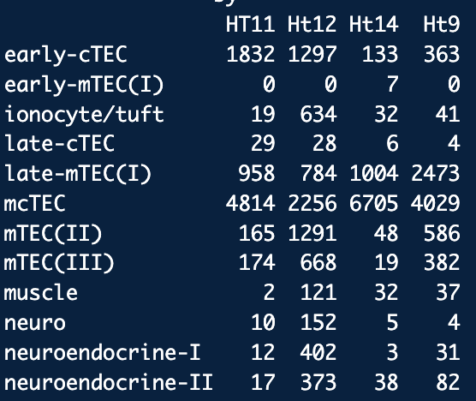
Cell Type Counts

